Slide 1
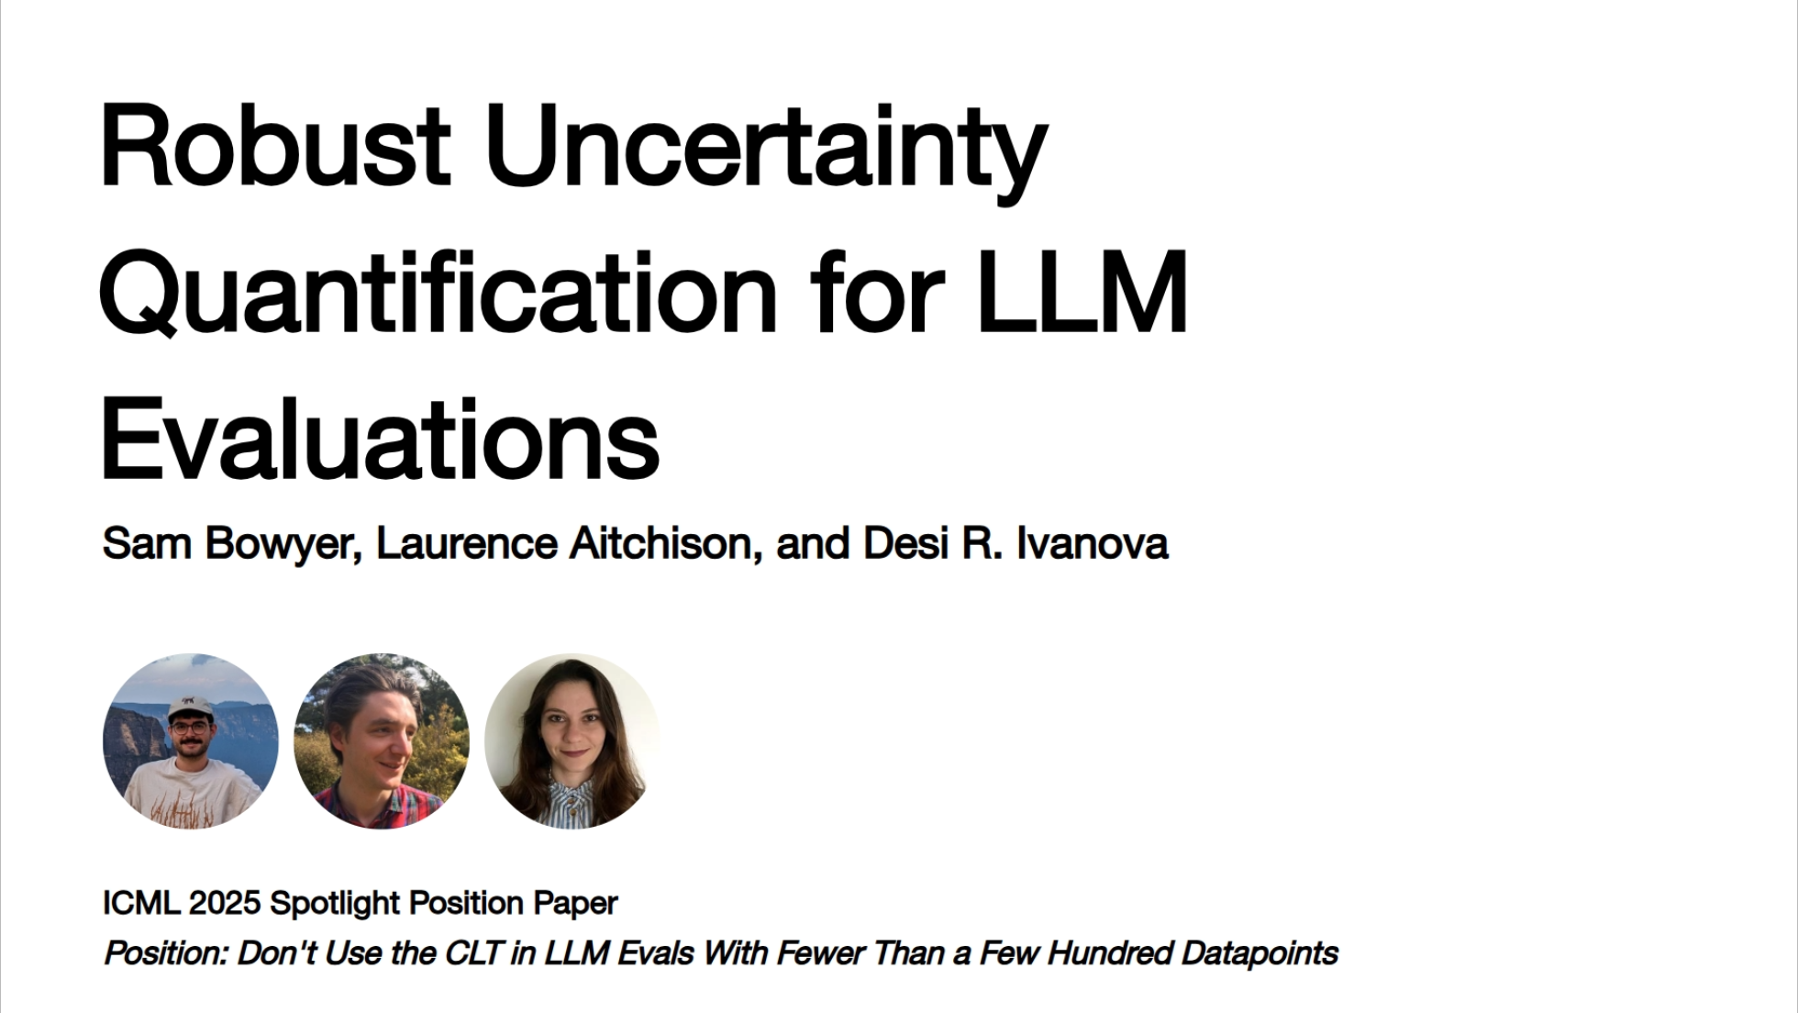

Slide 2


Slide 3
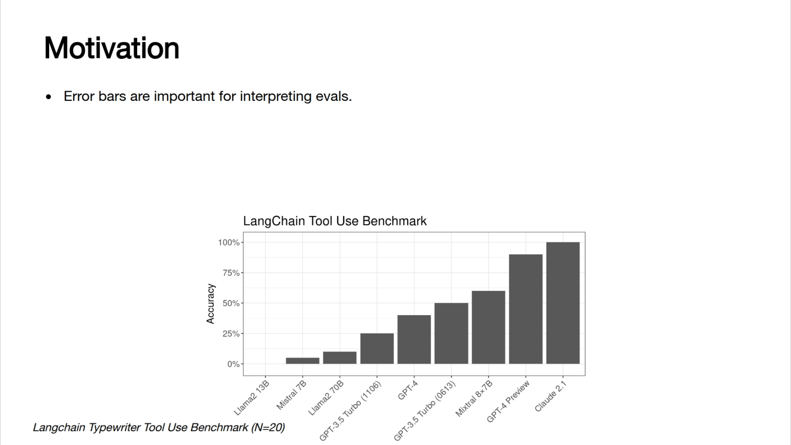

Slide 4
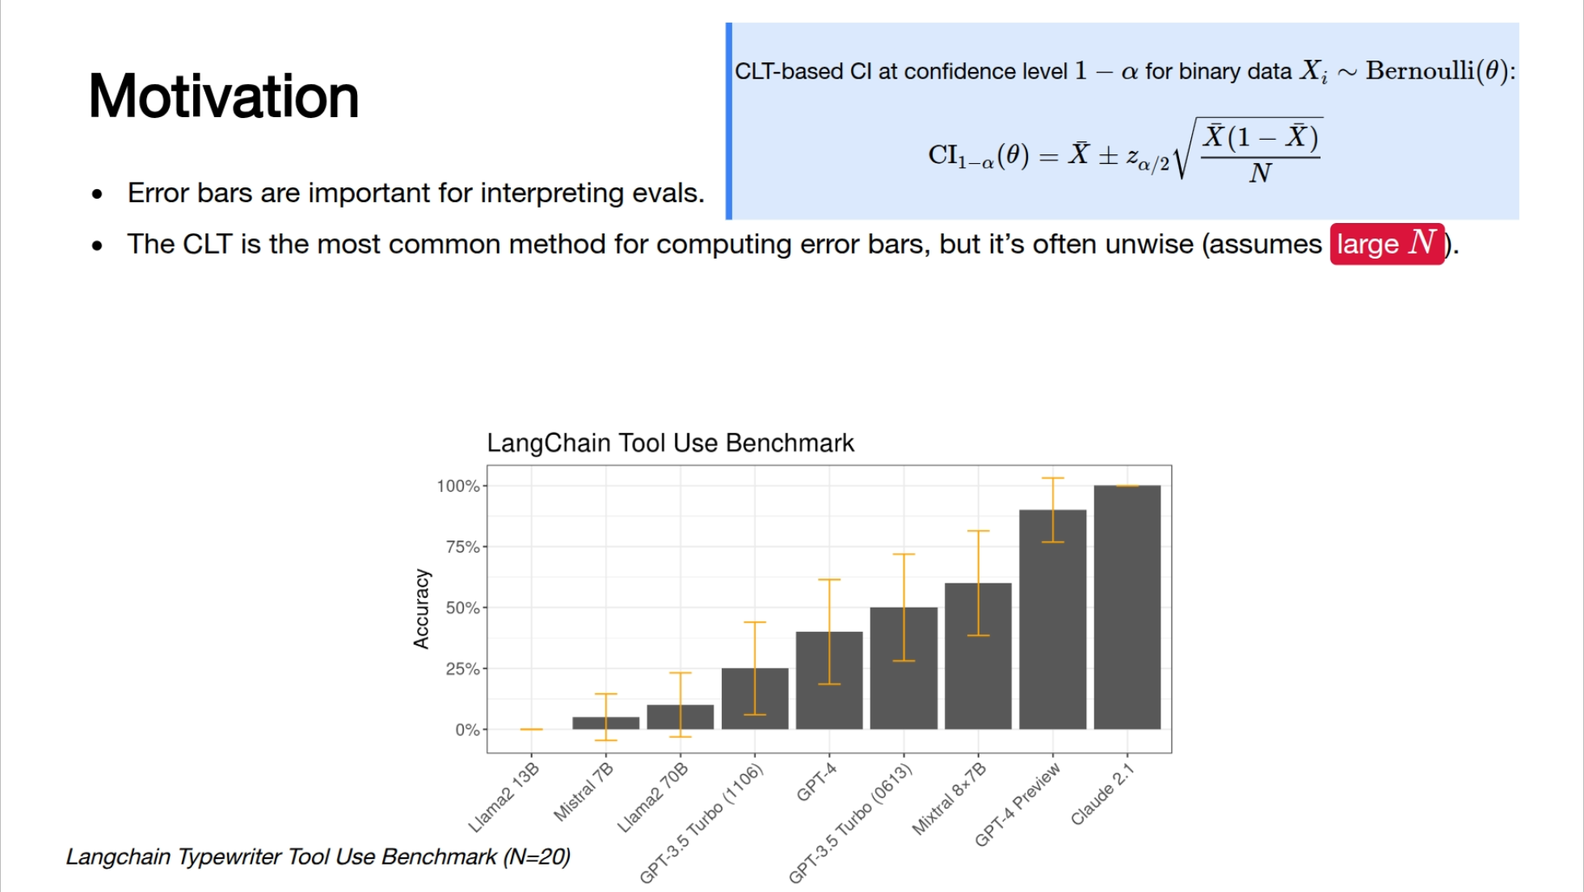

Slide 5
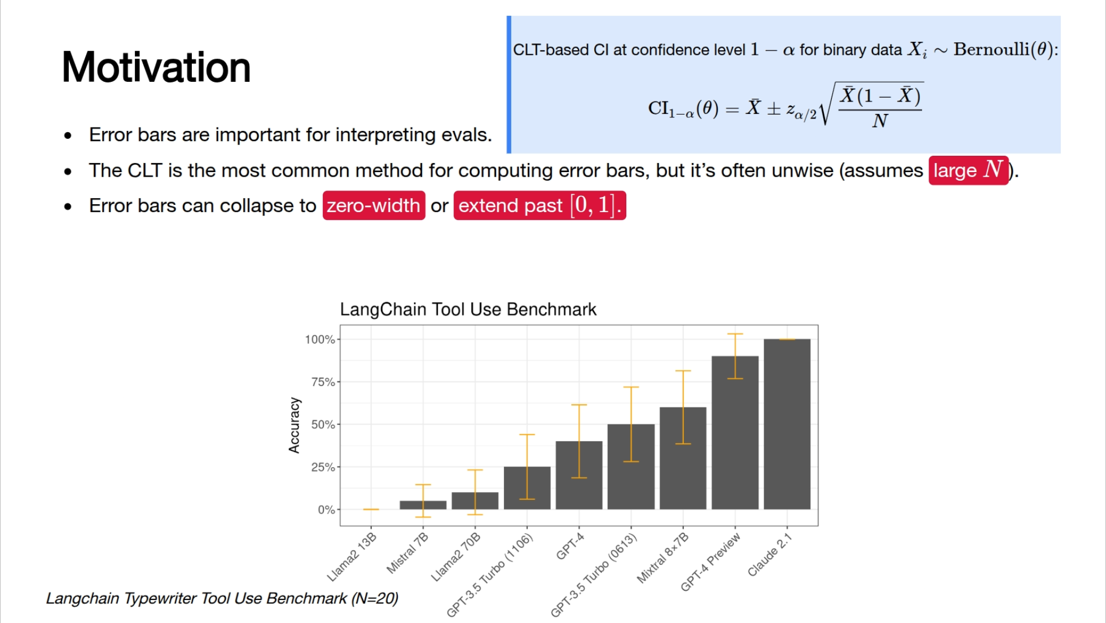

Slide 6


Slide 7
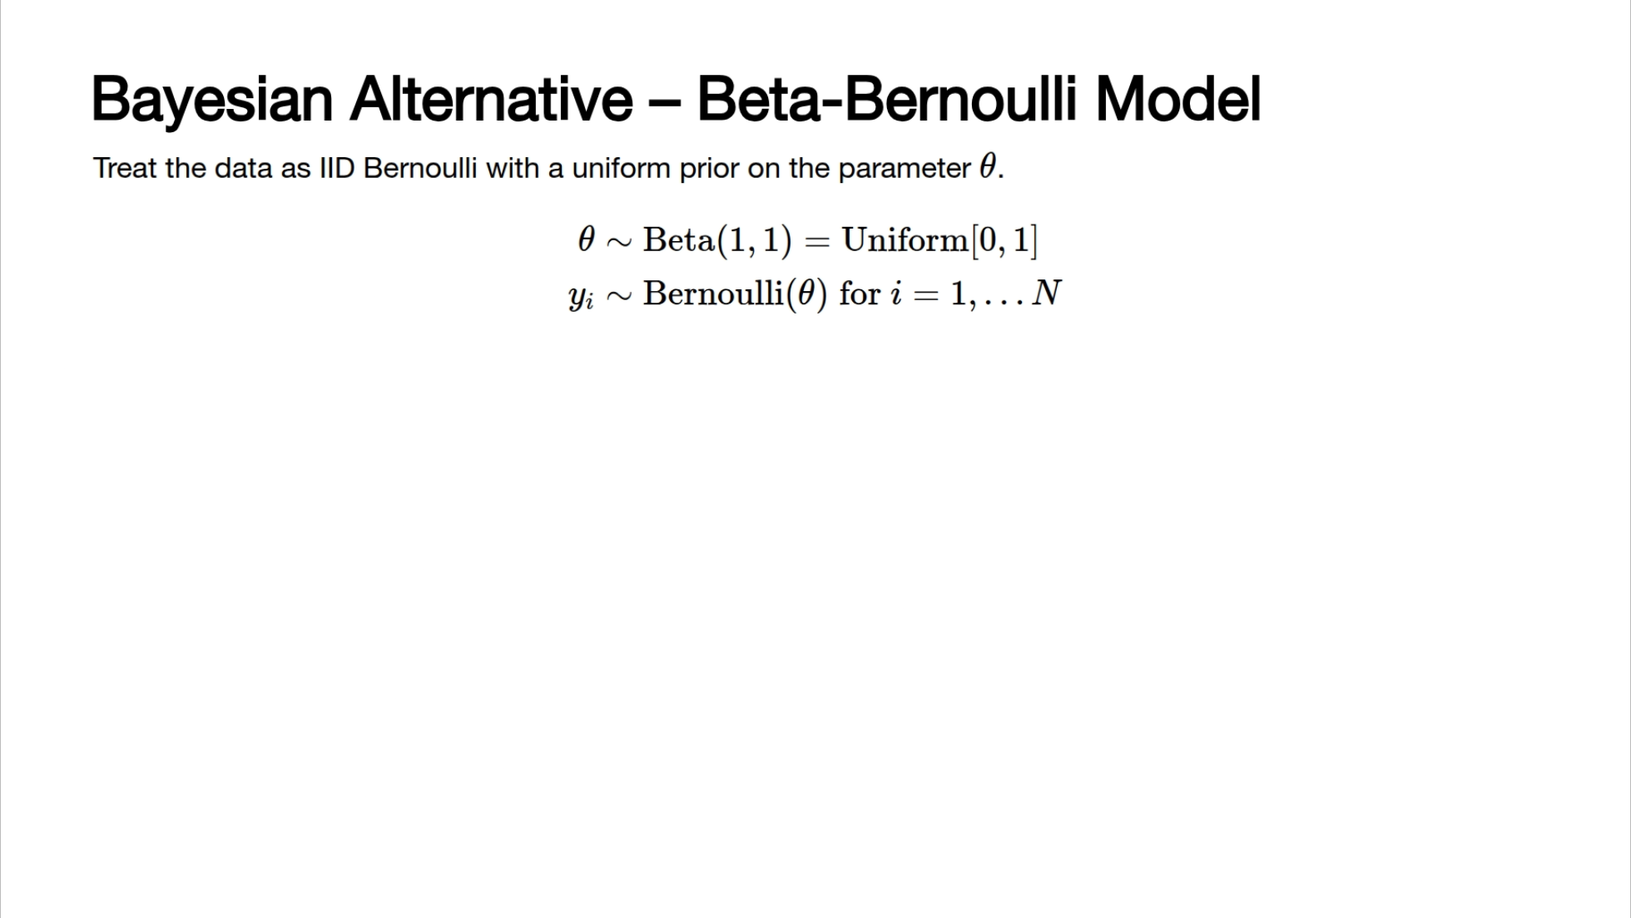
Notes:
--- # Frequentist vs. Bayesian Intervals <div class="h-10"></div> <v-clicks depth="2"> - Frequentist *confidence interval:* - <span class="highlight-red">The parameter is fixed but unknown,</span> the interval is a random variable depending on the data. - "*If we repeated the experiment many times, $100 \times (1-\alpha)\%$ of the time the interval would contain the true parameter.*" - Bayesian *credible interval:* - <span class="highlight-red">The parameter is random,</span> we infer the posterior distribution of the parameter given the data. - "*There is a $100 \times (1-\alpha)\%$ probability that the interval contains the true parameter. (Under some modelling assumptions.)*" </v-clicks>

Slide 8
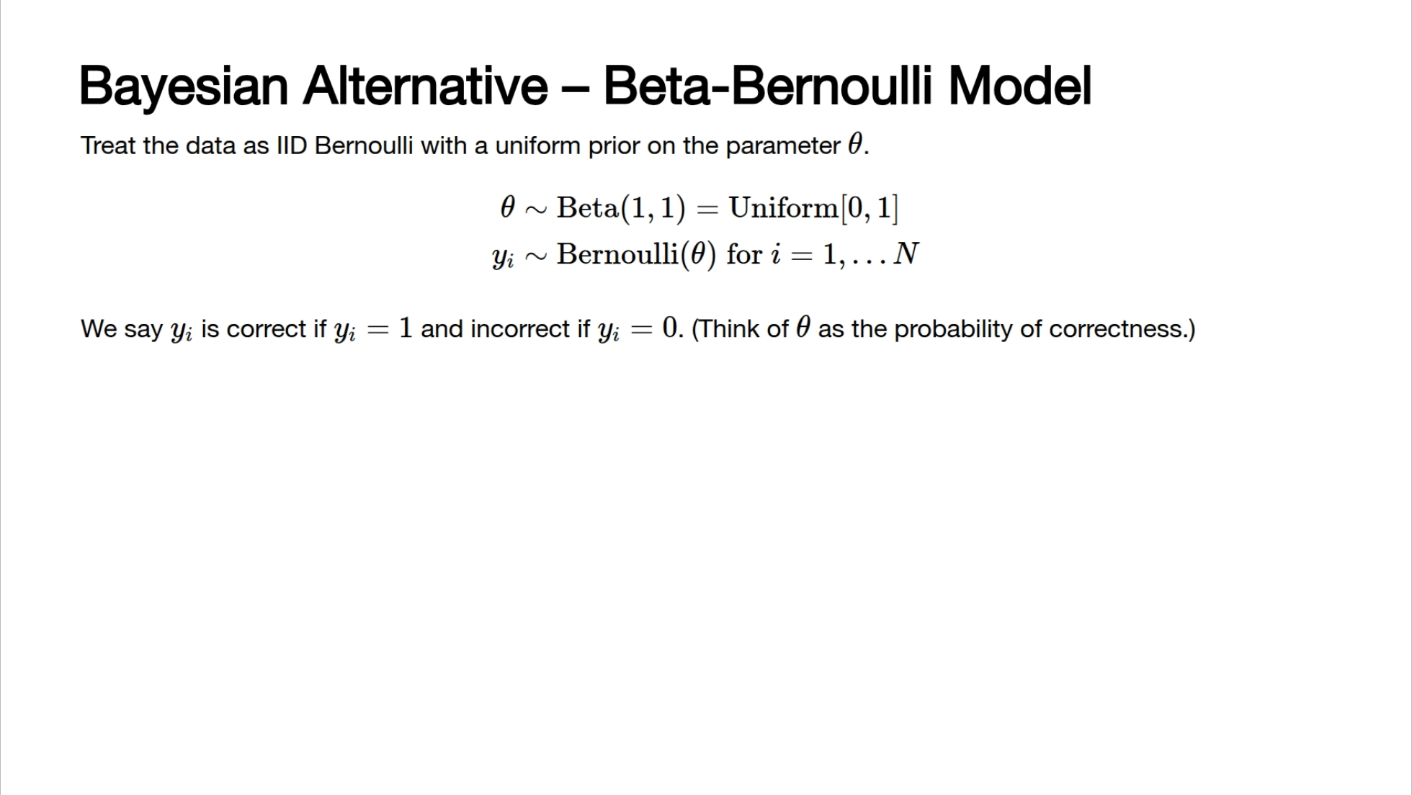
Notes:
--- # Frequentist vs. Bayesian Intervals <div class="h-10"></div> <v-clicks depth="2"> - Frequentist *confidence interval:* - <span class="highlight-red">The parameter is fixed but unknown,</span> the interval is a random variable depending on the data. - "*If we repeated the experiment many times, $100 \times (1-\alpha)\%$ of the time the interval would contain the true parameter.*" - Bayesian *credible interval:* - <span class="highlight-red">The parameter is random,</span> we infer the posterior distribution of the parameter given the data. - "*There is a $100 \times (1-\alpha)\%$ probability that the interval contains the true parameter. (Under some modelling assumptions.)*" </v-clicks>

Slide 9
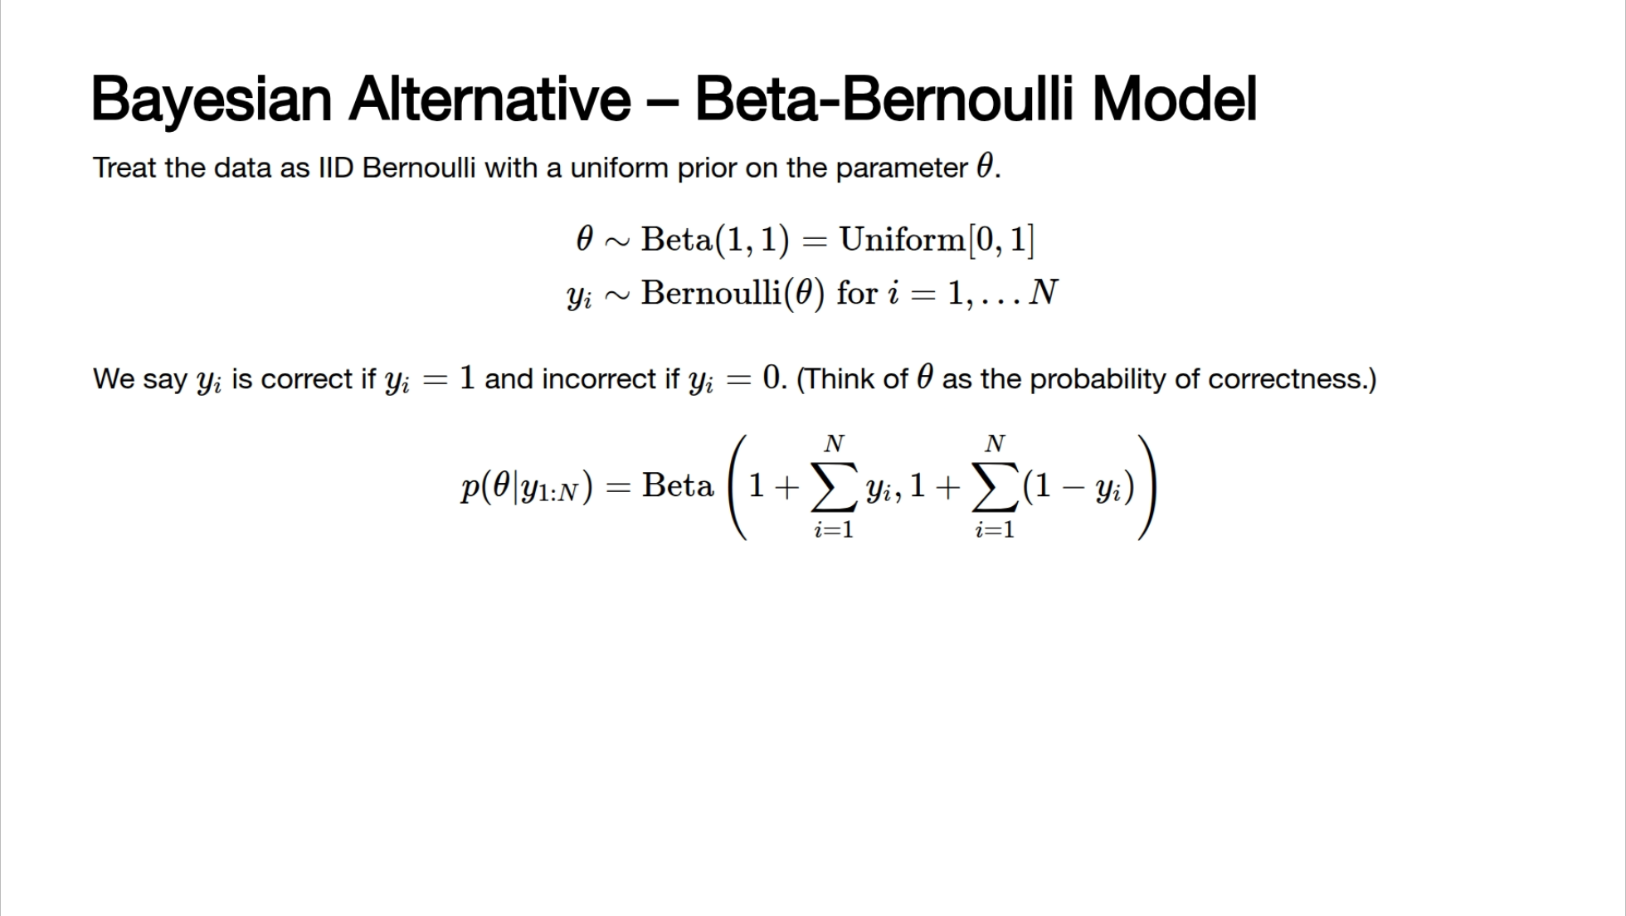
Notes:
--- # Frequentist vs. Bayesian Intervals <div class="h-10"></div> <v-clicks depth="2"> - Frequentist *confidence interval:* - <span class="highlight-red">The parameter is fixed but unknown,</span> the interval is a random variable depending on the data. - "*If we repeated the experiment many times, $100 \times (1-\alpha)\%$ of the time the interval would contain the true parameter.*" - Bayesian *credible interval:* - <span class="highlight-red">The parameter is random,</span> we infer the posterior distribution of the parameter given the data. - "*There is a $100 \times (1-\alpha)\%$ probability that the interval contains the true parameter. (Under some modelling assumptions.)*" </v-clicks>

Slide 10
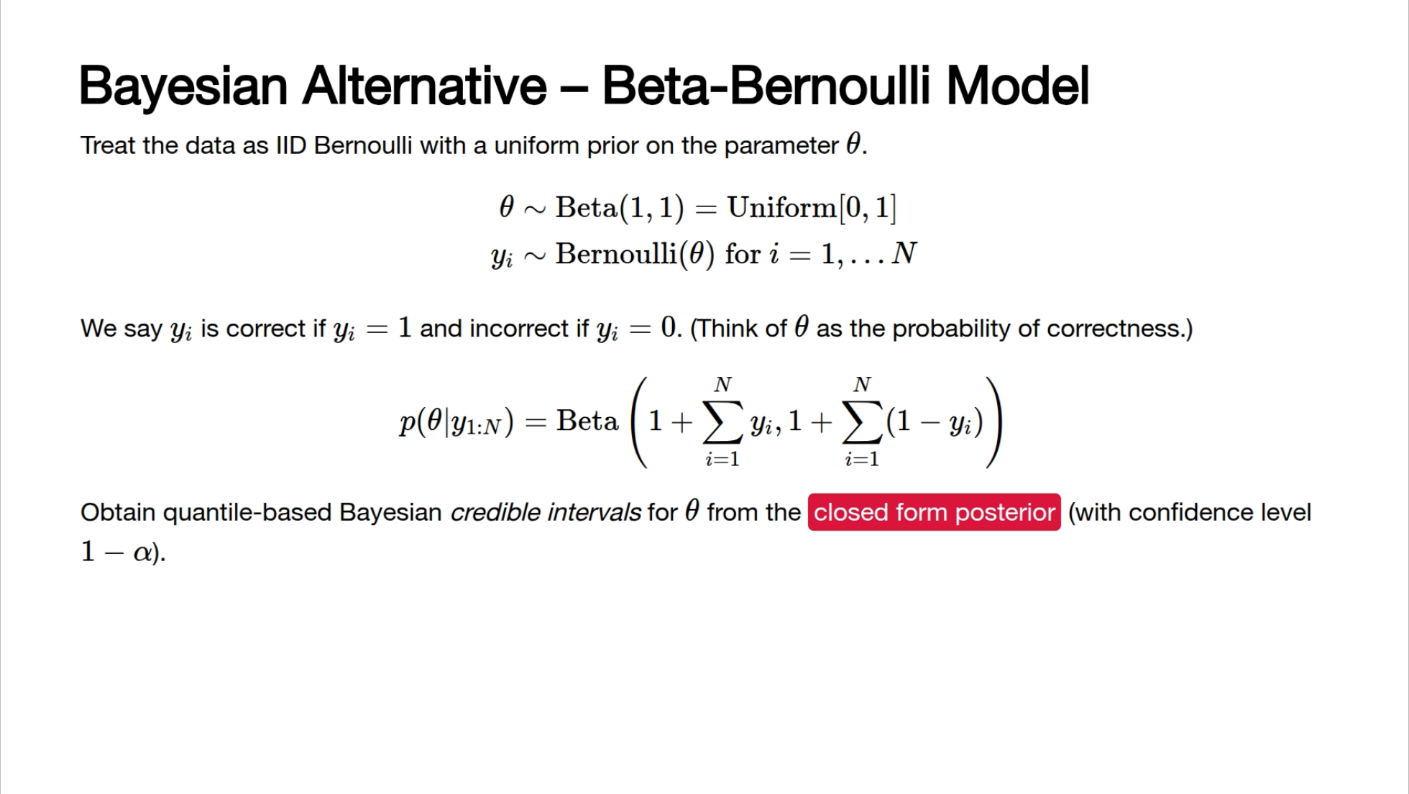
Notes:
--- # Frequentist vs. Bayesian Intervals <div class="h-10"></div> <v-clicks depth="2"> - Frequentist *confidence interval:* - <span class="highlight-red">The parameter is fixed but unknown,</span> the interval is a random variable depending on the data. - "*If we repeated the experiment many times, $100 \times (1-\alpha)\%$ of the time the interval would contain the true parameter.*" - Bayesian *credible interval:* - <span class="highlight-red">The parameter is random,</span> we infer the posterior distribution of the parameter given the data. - "*There is a $100 \times (1-\alpha)\%$ probability that the interval contains the true parameter. (Under some modelling assumptions.)*" </v-clicks>

Slide 11
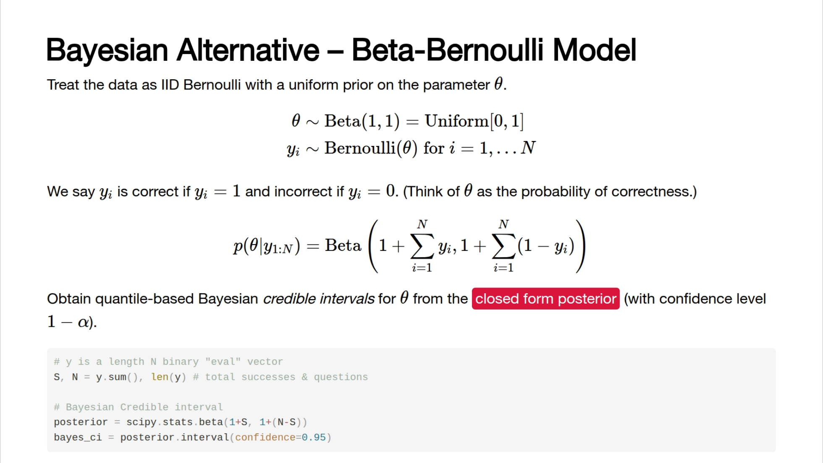
Notes:
--- # Frequentist vs. Bayesian Intervals <div class="h-10"></div> <v-clicks depth="2"> - Frequentist *confidence interval:* - <span class="highlight-red">The parameter is fixed but unknown,</span> the interval is a random variable depending on the data. - "*If we repeated the experiment many times, $100 \times (1-\alpha)\%$ of the time the interval would contain the true parameter.*" - Bayesian *credible interval:* - <span class="highlight-red">The parameter is random,</span> we infer the posterior distribution of the parameter given the data. - "*There is a $100 \times (1-\alpha)\%$ probability that the interval contains the true parameter. (Under some modelling assumptions.)*" </v-clicks>

Slide 12


Slide 13
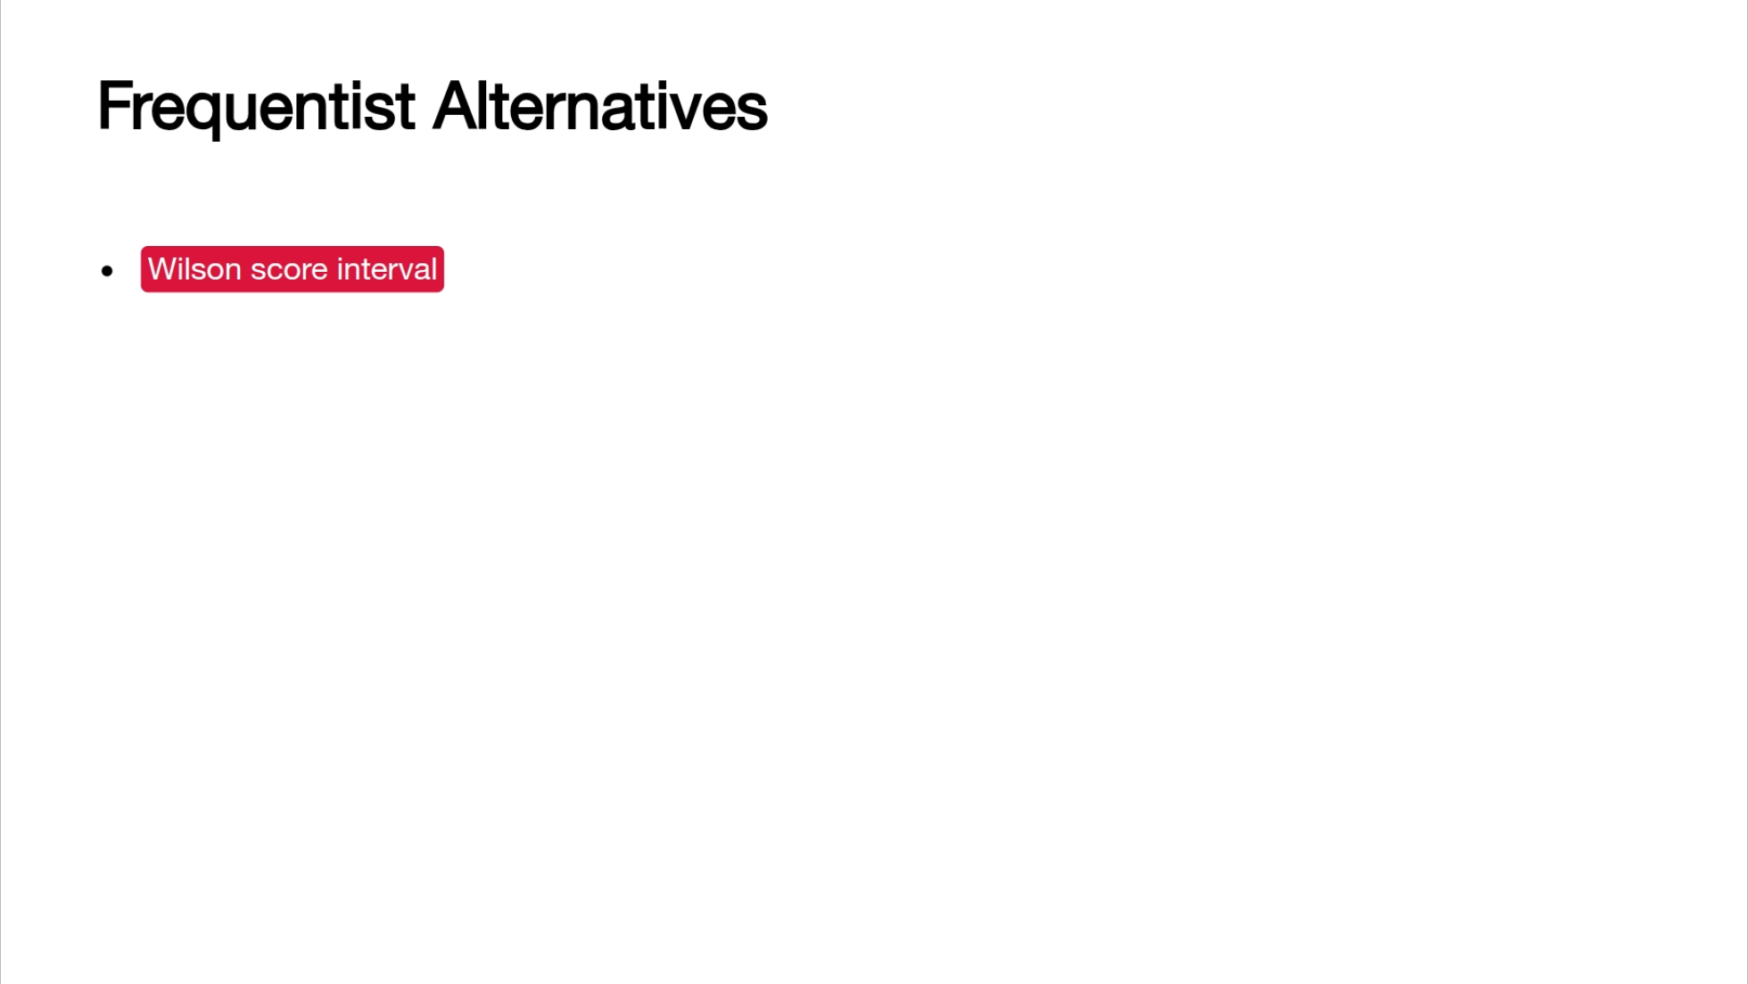

Slide 14
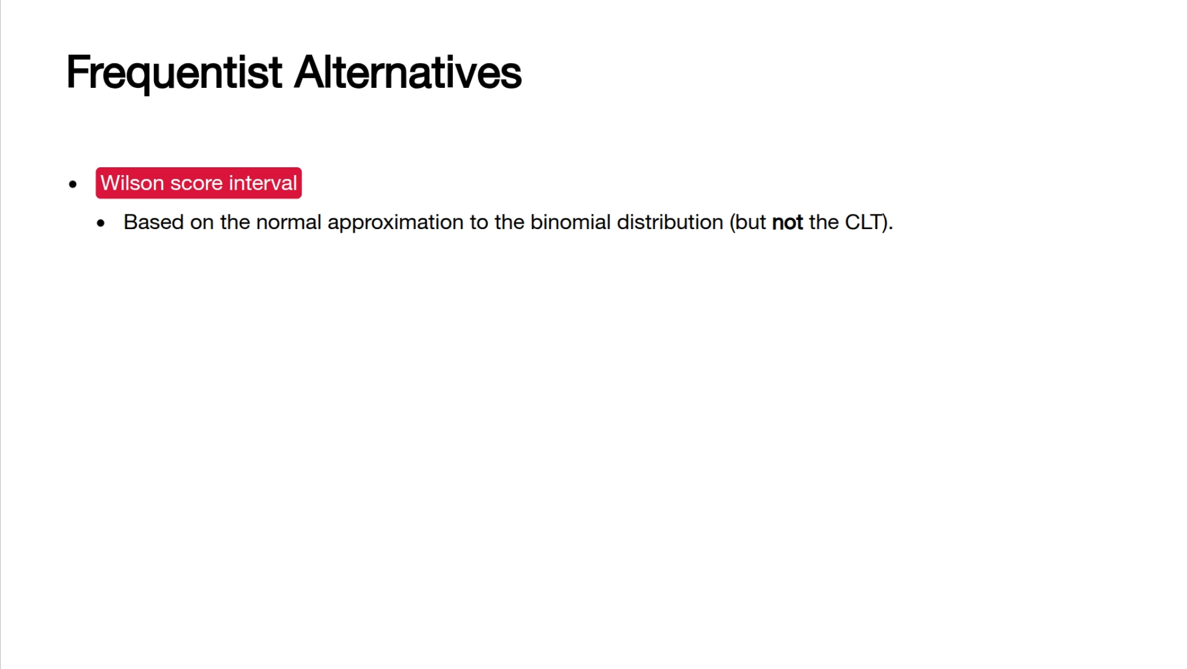

Slide 15
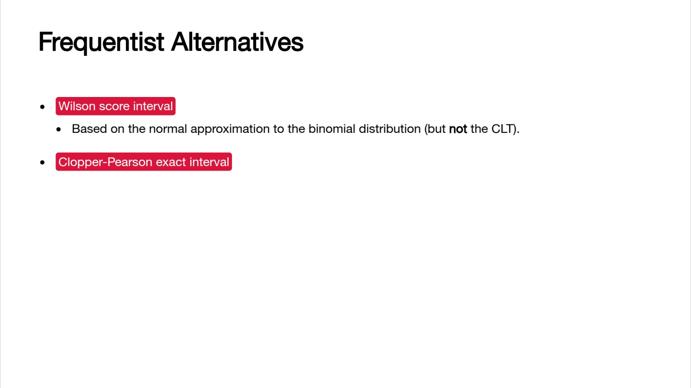

Slide 16
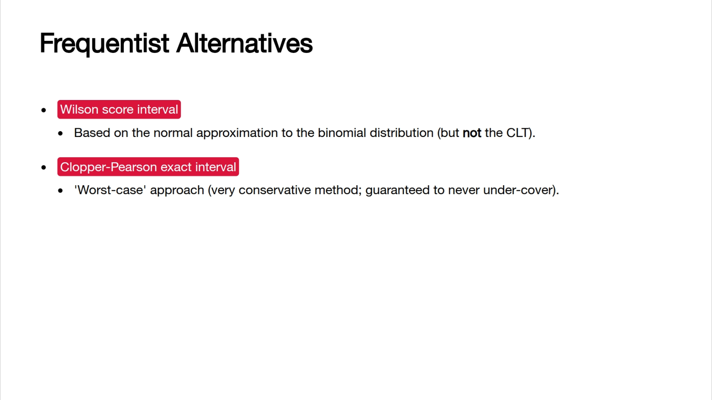

Slide 17
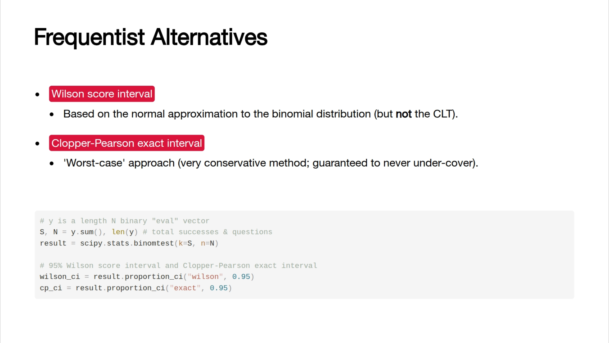

Slide 18
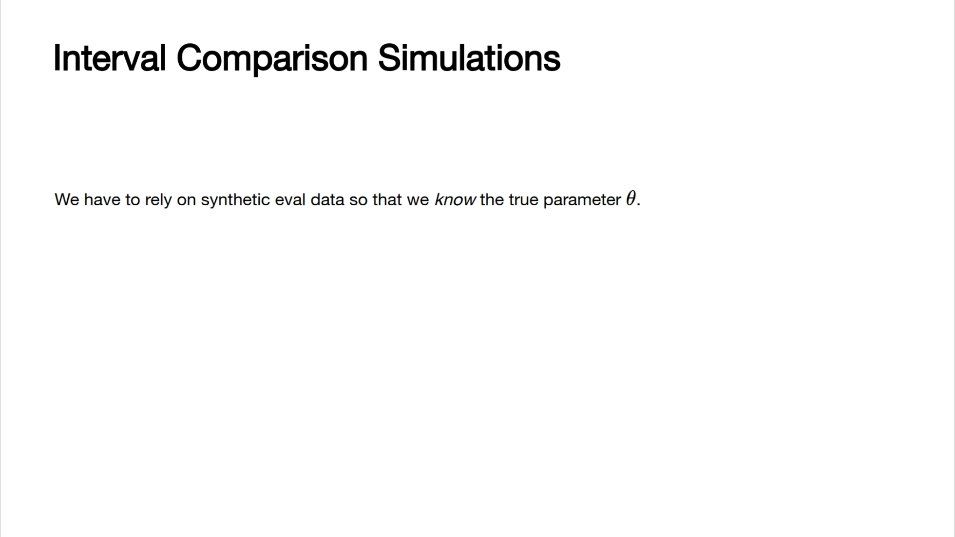

Slide 19
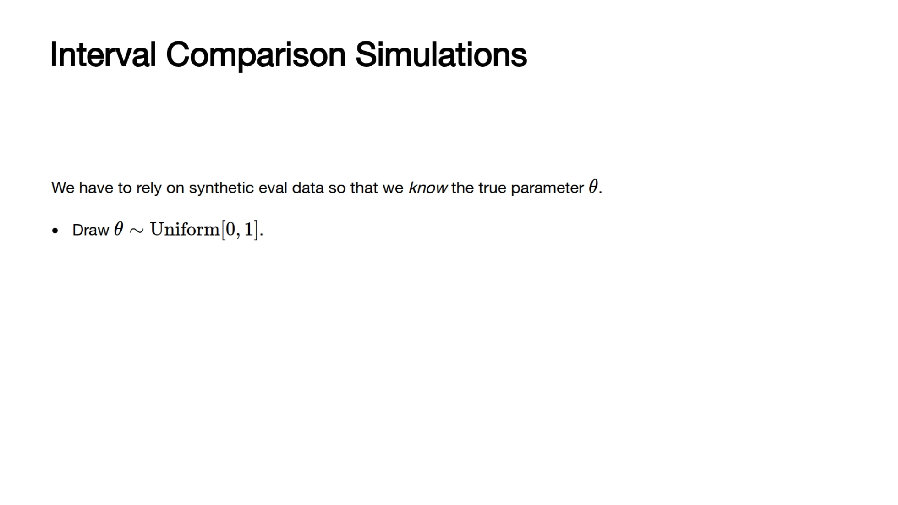

Slide 20
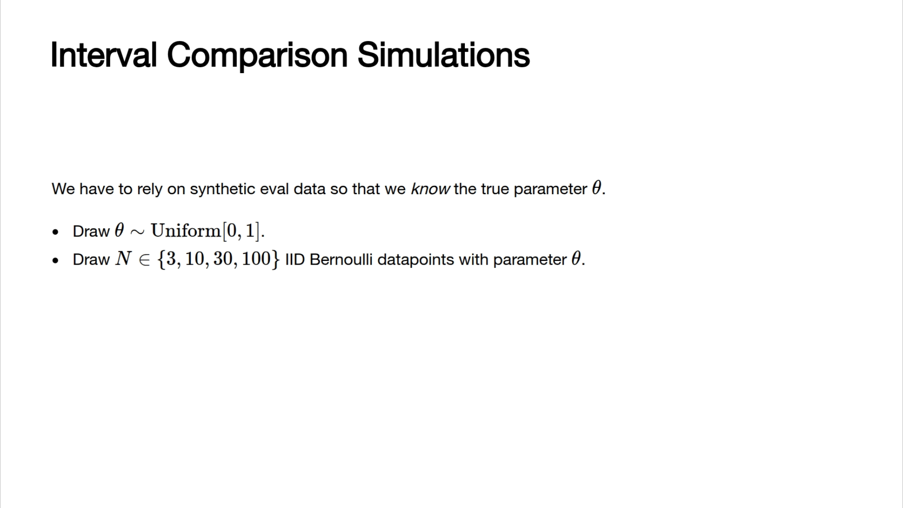

Slide 21
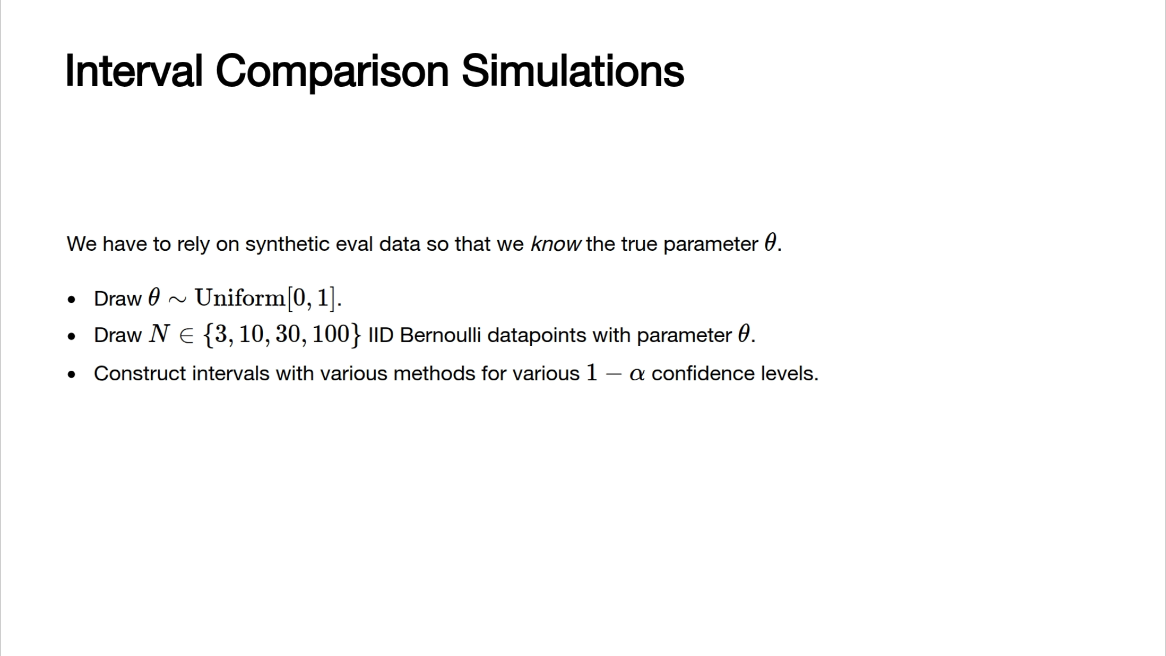

Slide 22
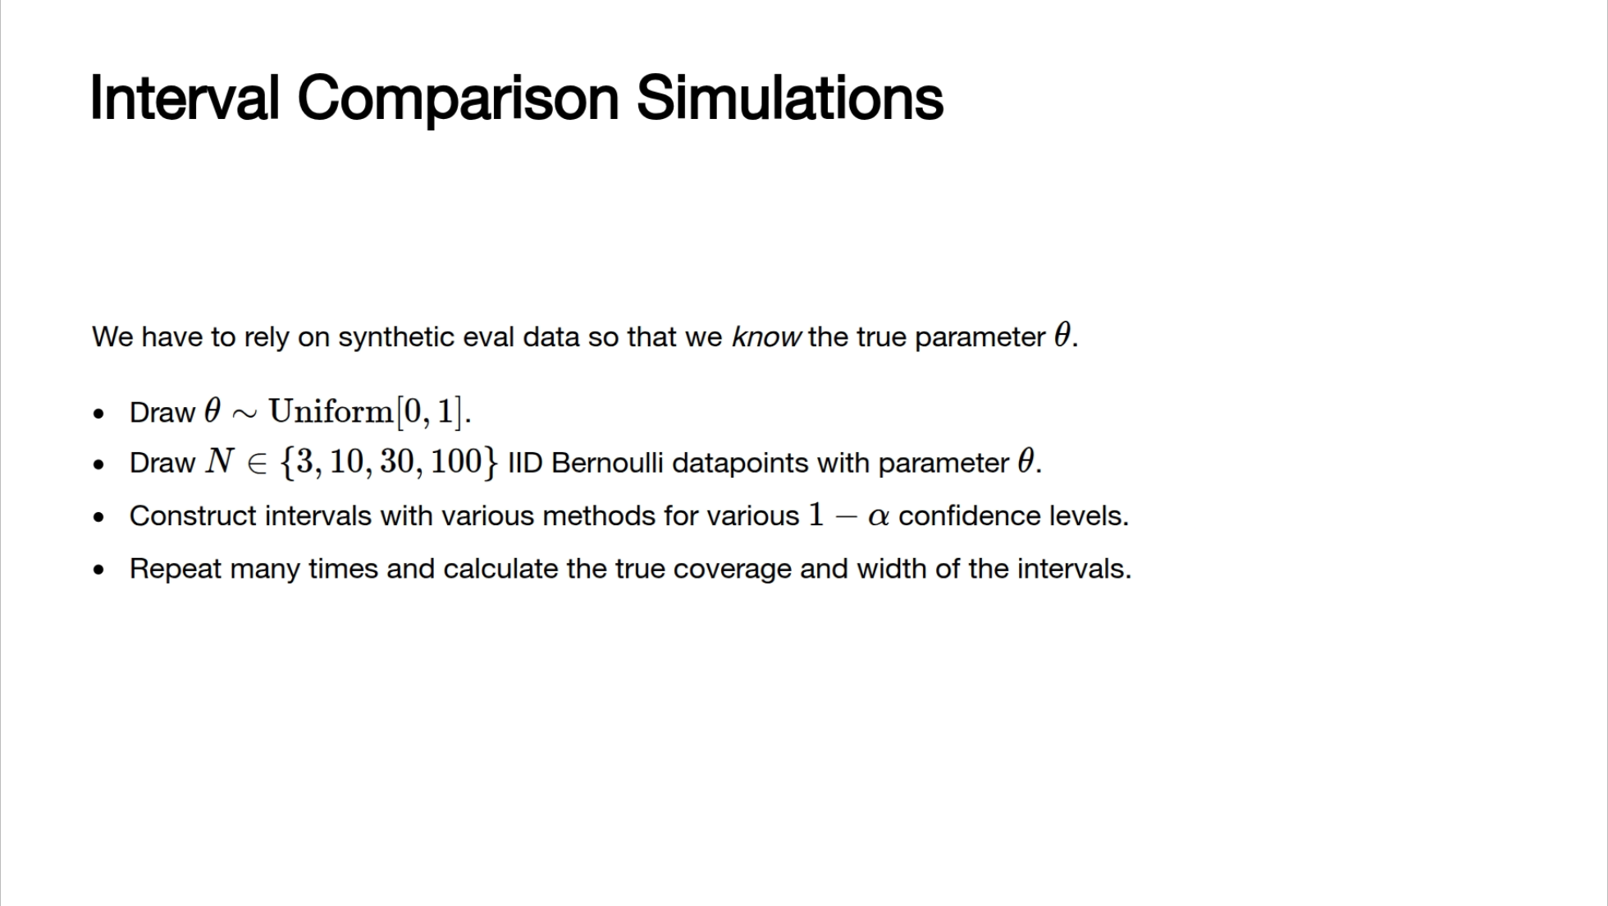

Slide 23
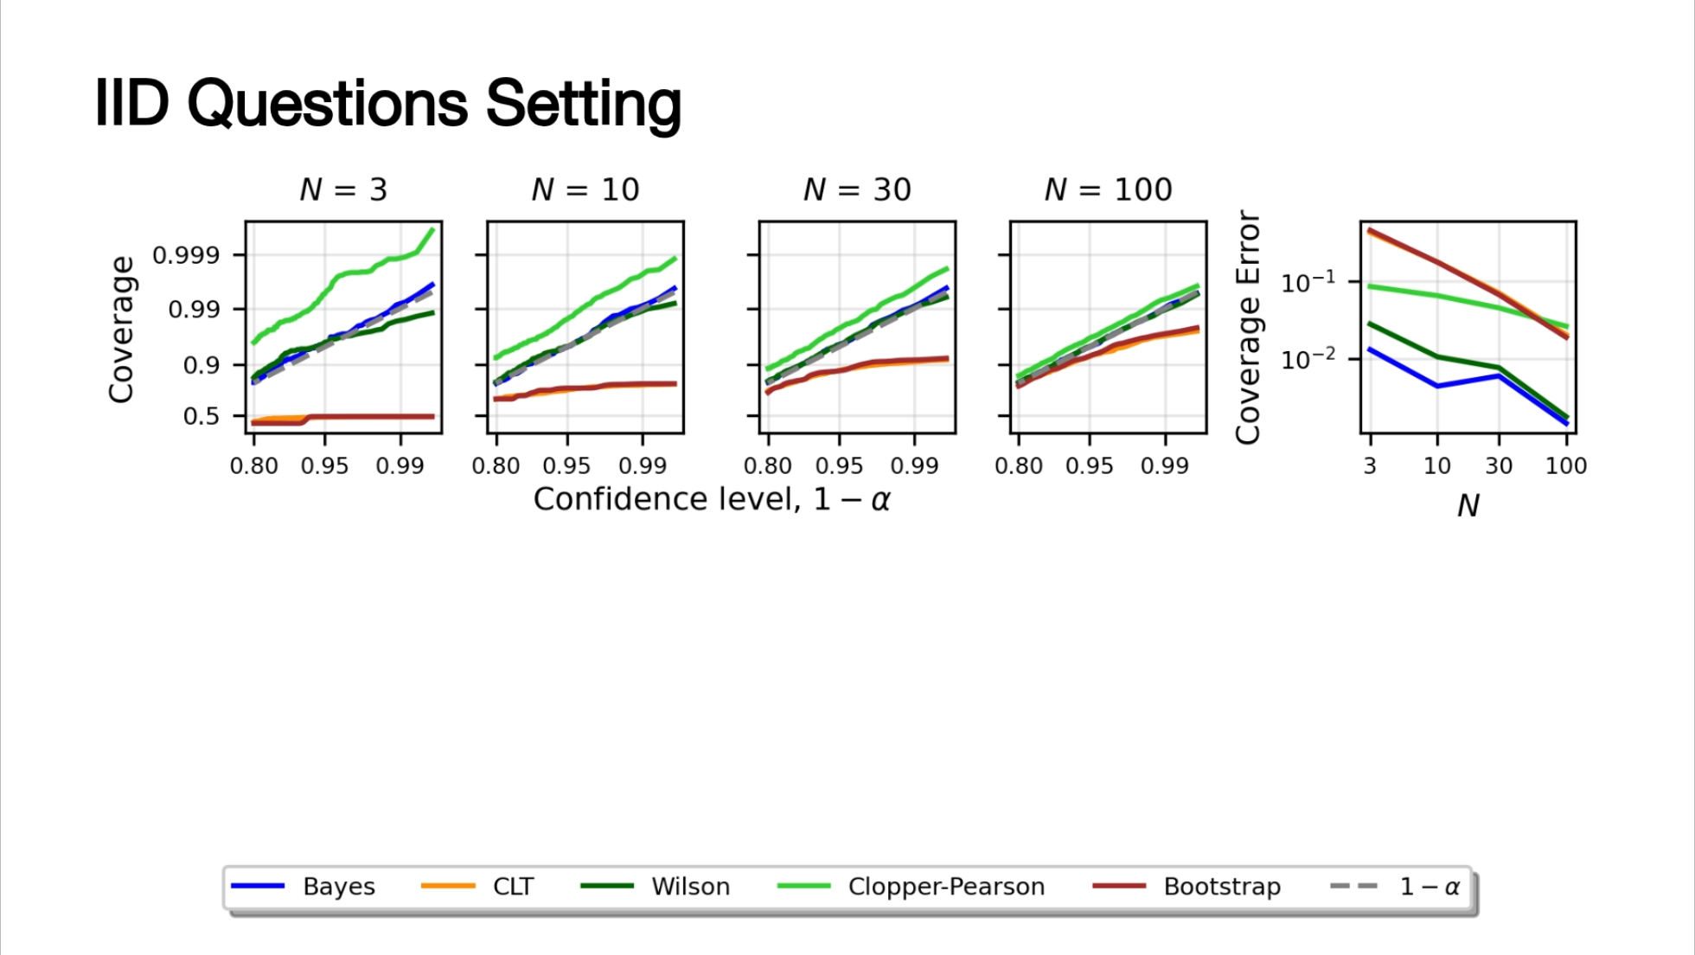

Slide 24
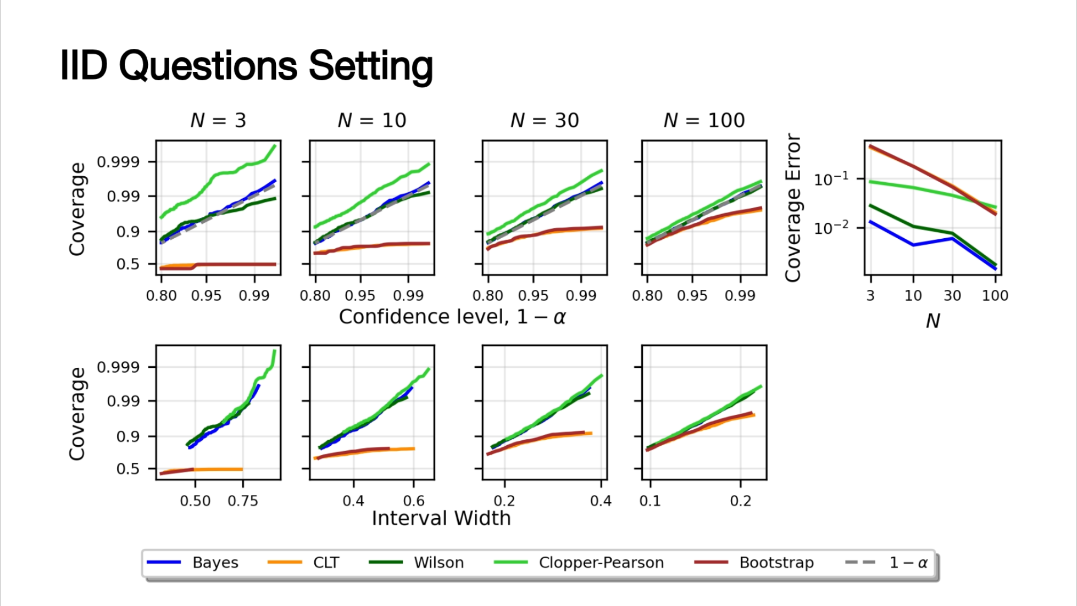

Slide 25
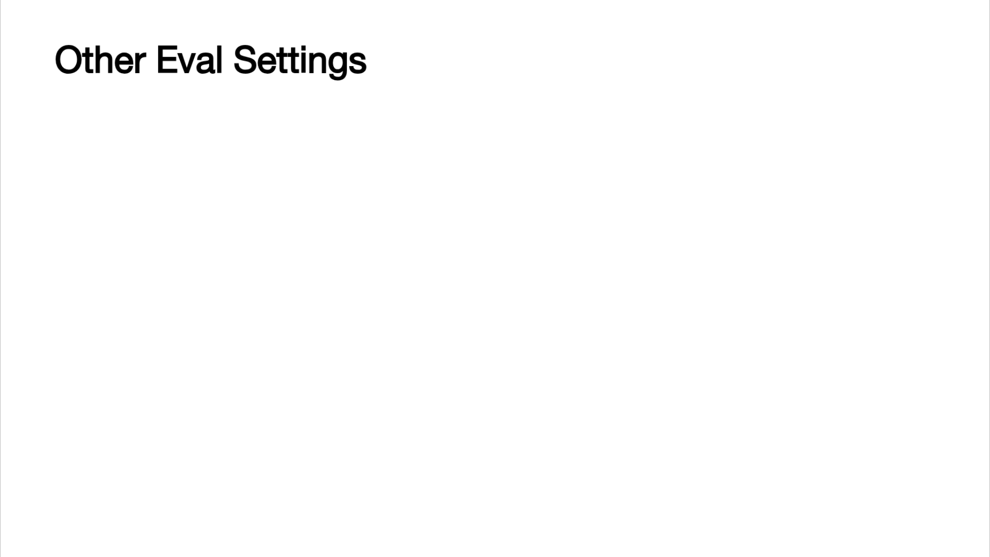

Slide 26
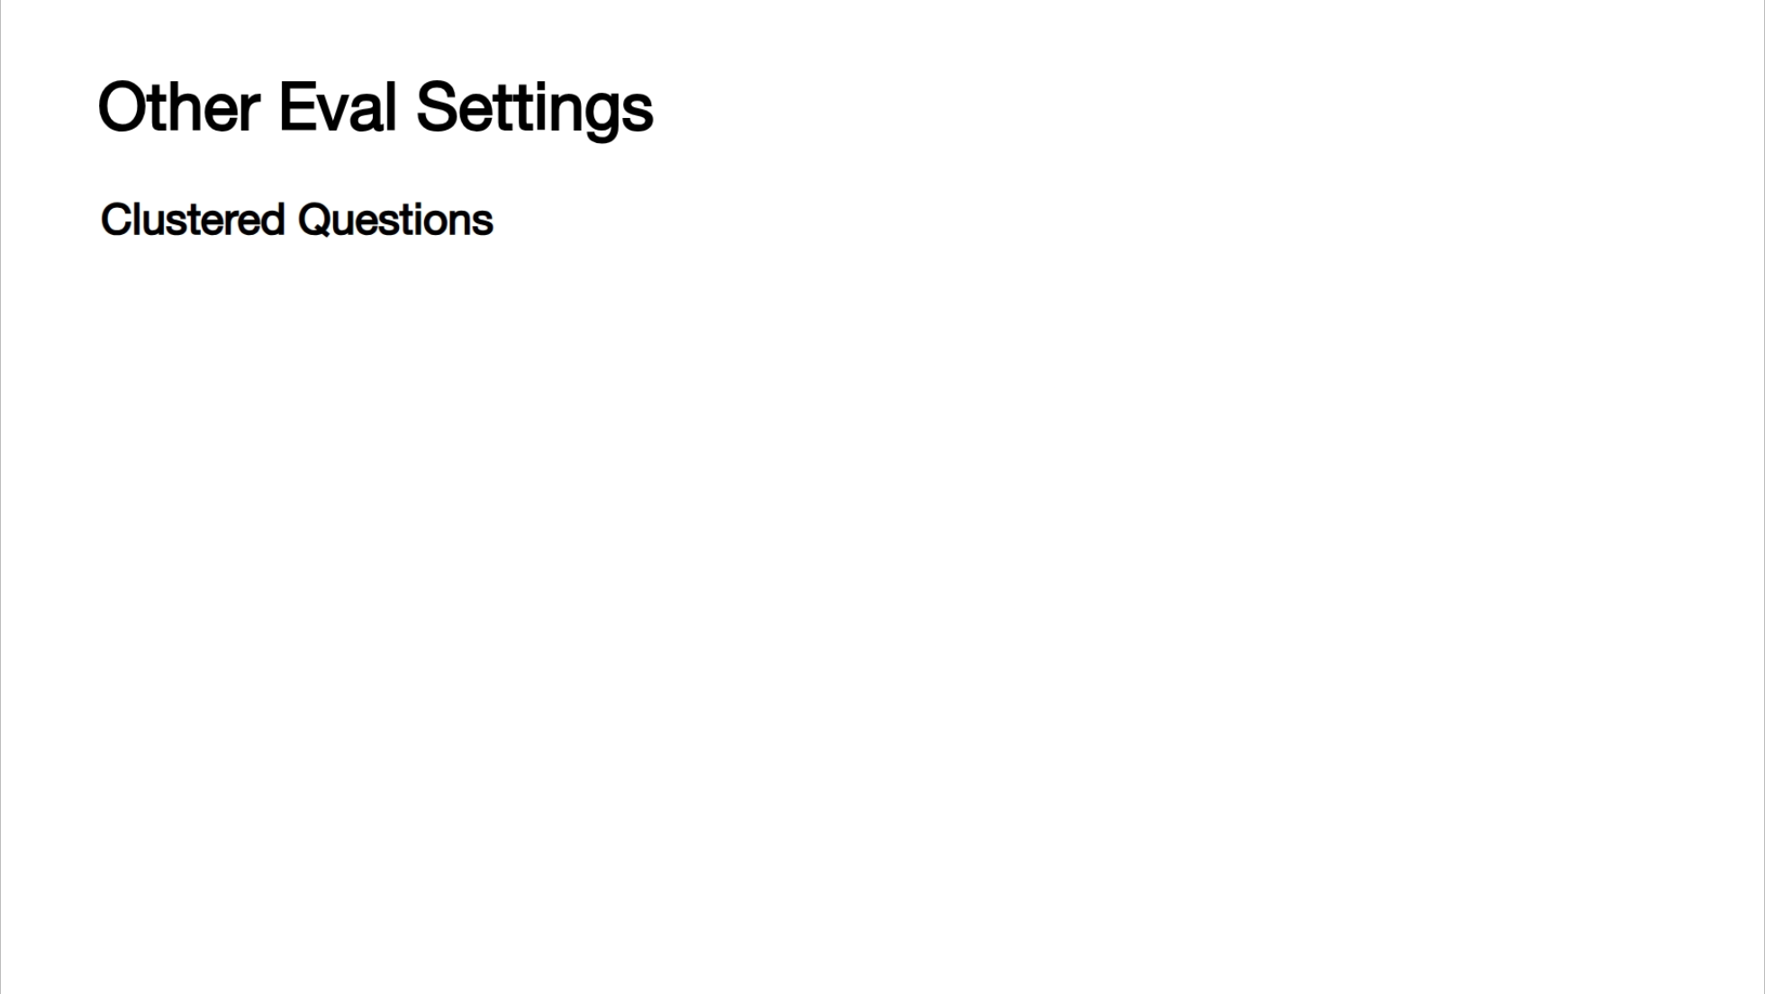

Slide 27
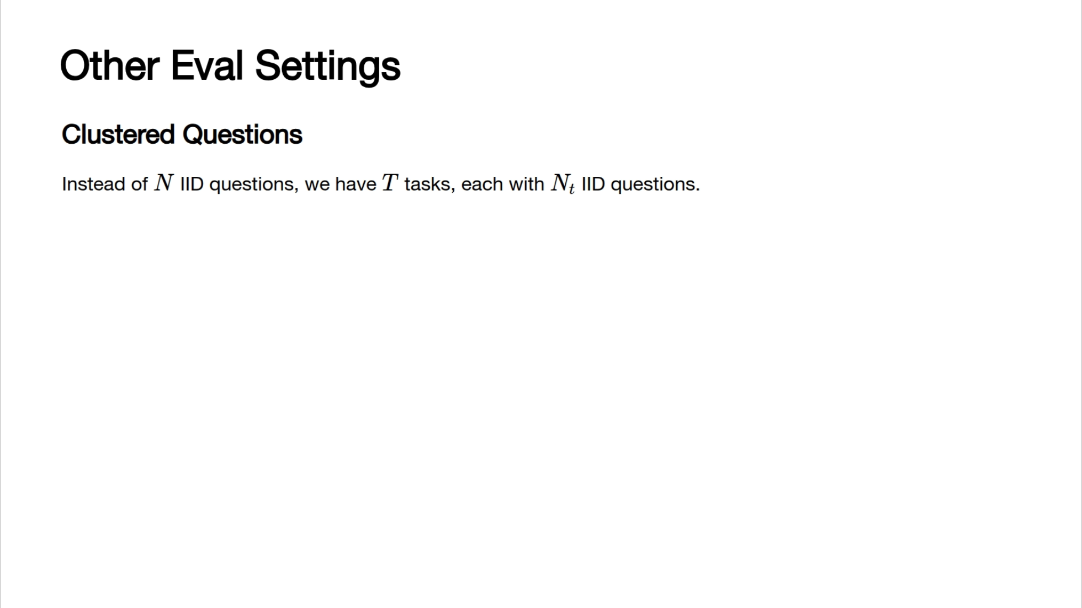

Slide 28
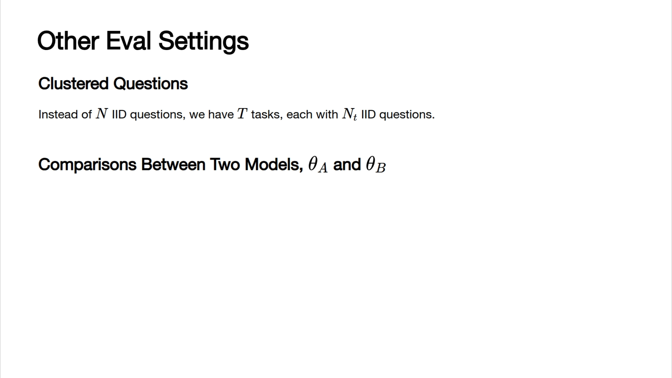

Slide 29
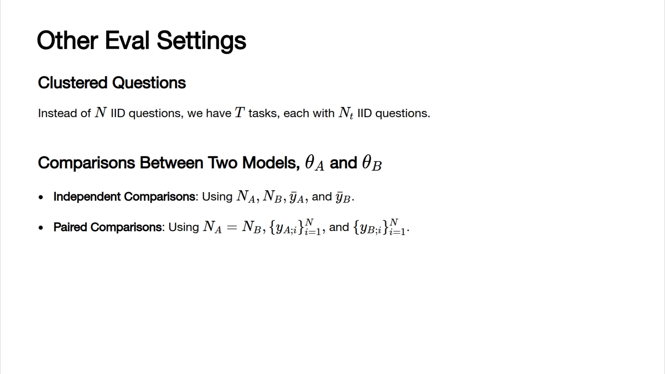

Slide 30
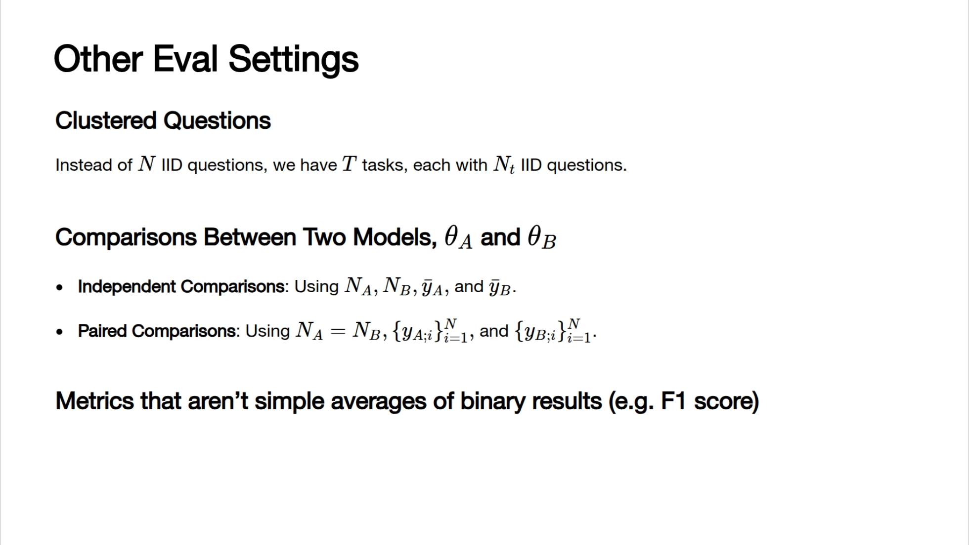

Slide 31
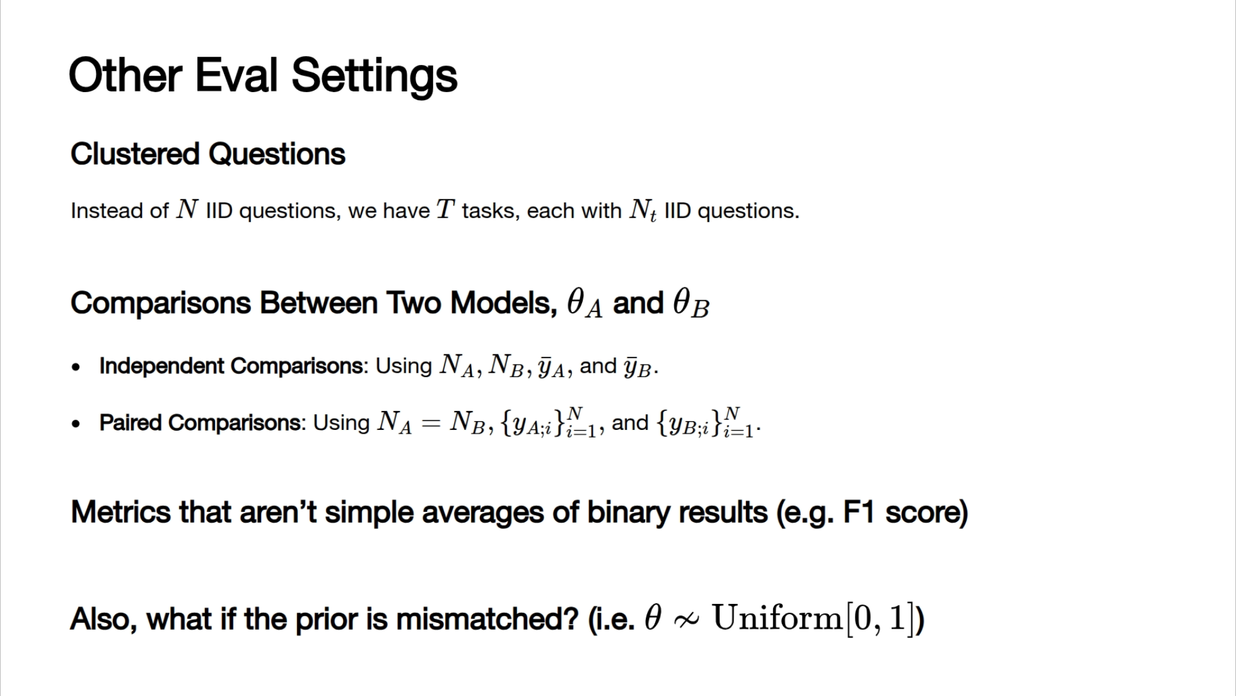

Slide 32
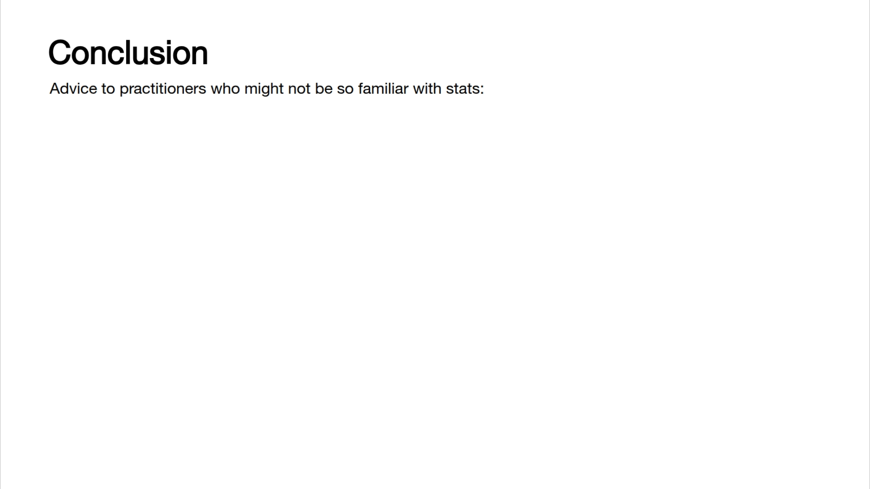

Slide 33
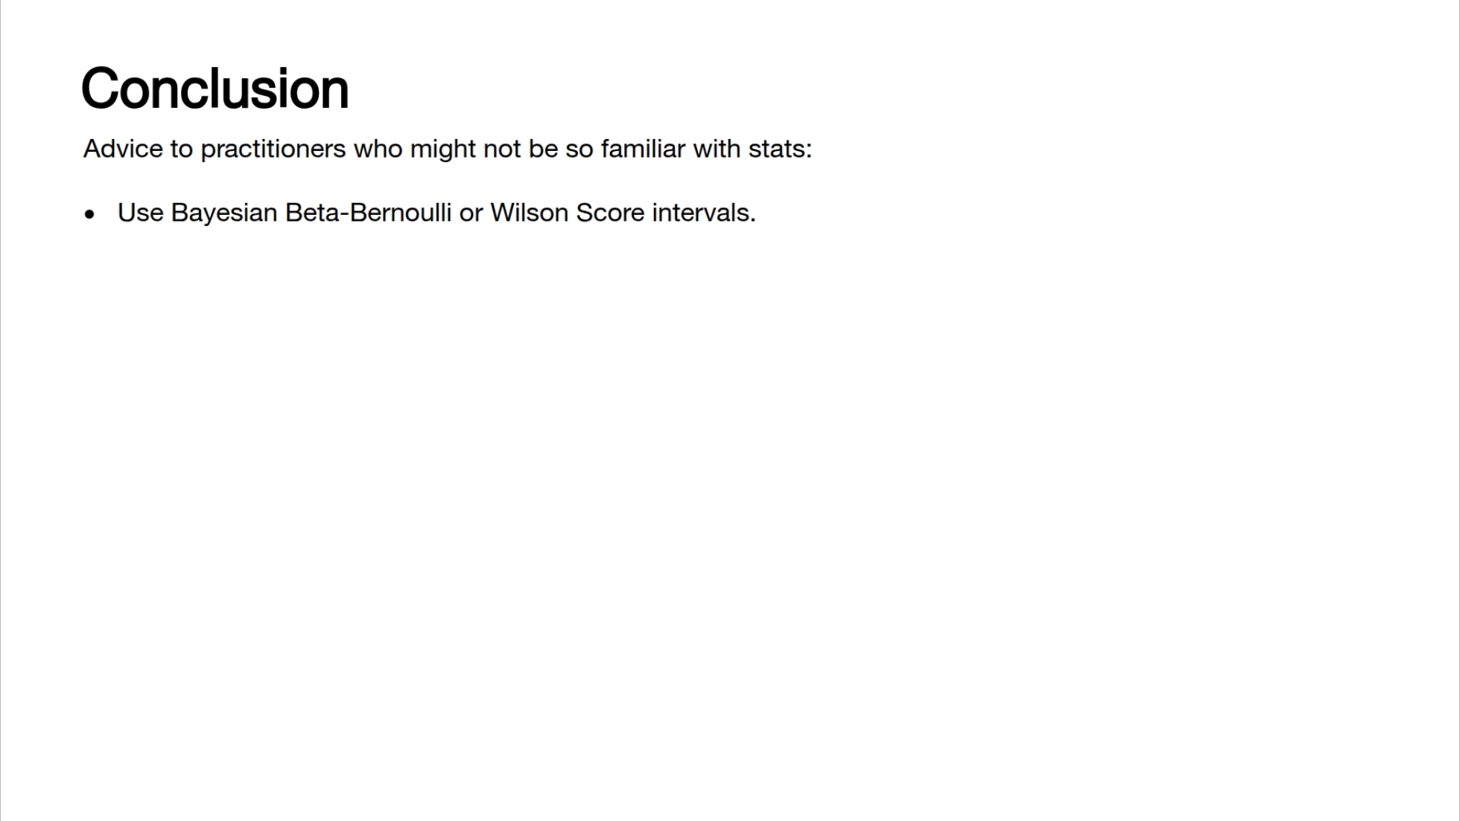

Slide 34
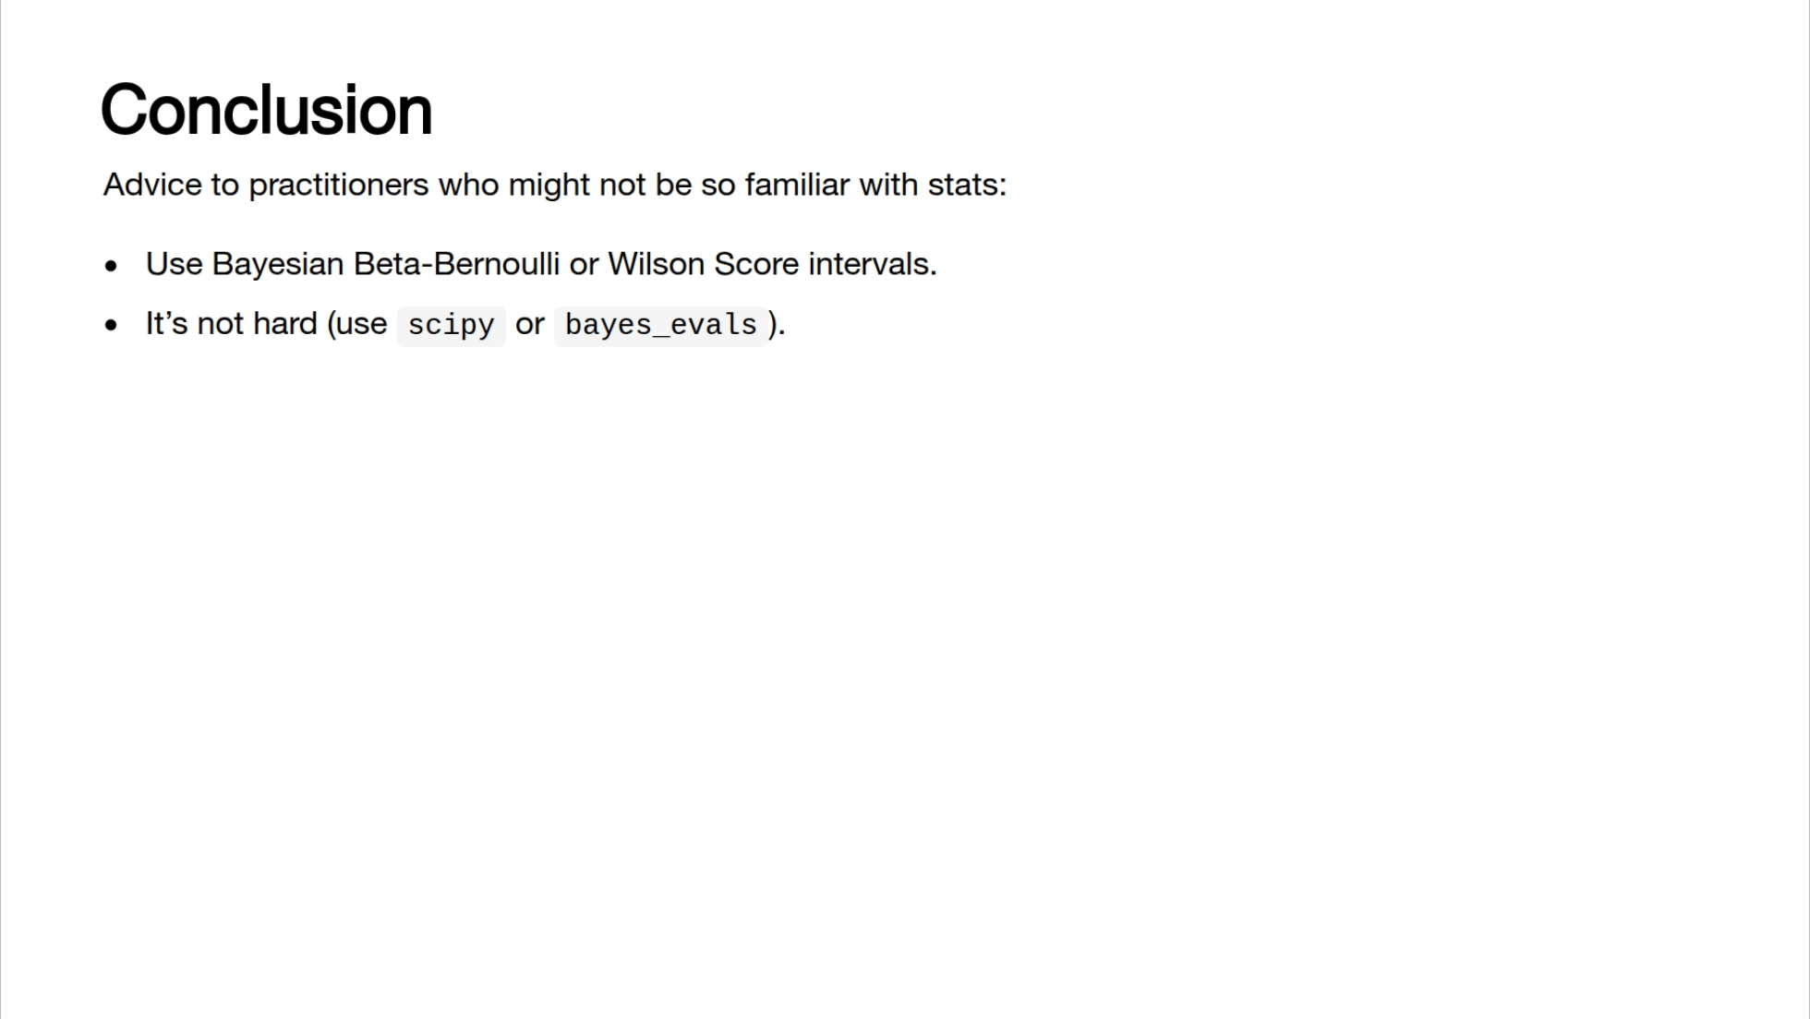

Slide 35
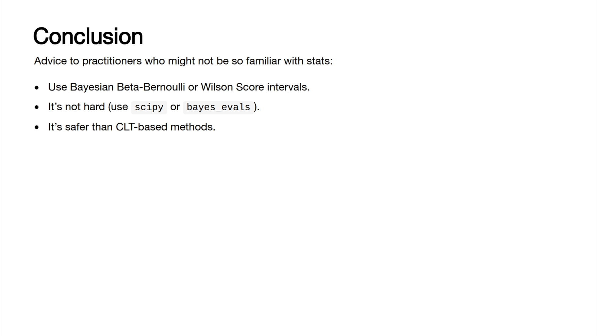

Slide 36
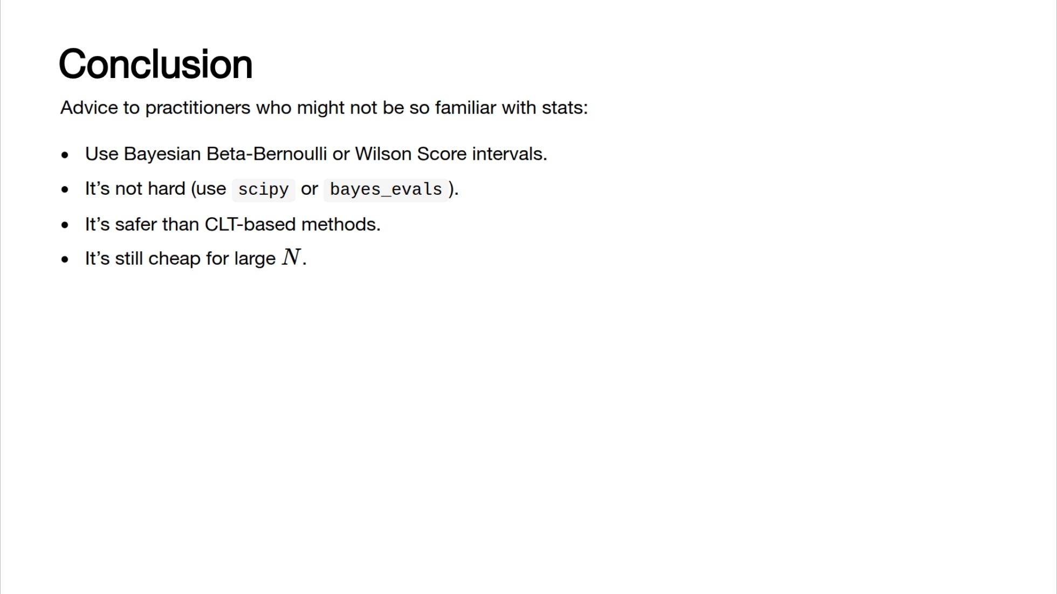

Slide 37
